Slide 1
Recurrence relations Matrix calculations

Slide 2
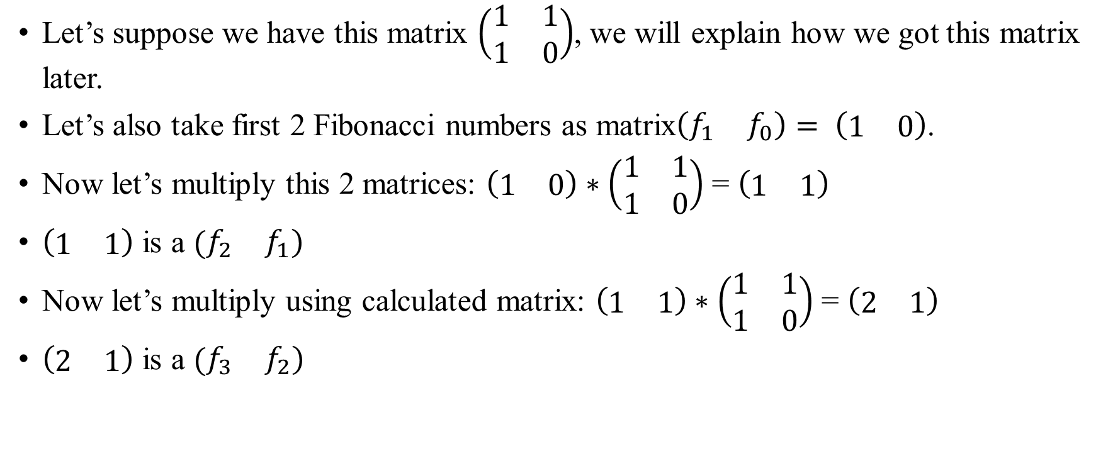
Recurrence relations Matrix calculation. Fibonacci example.
Let’s suppose we have this matrix $\left(\begin{matrix}1 & 1 \\ 1 & 0\end{matrix}\right)$, we will explain how we got this matrix later.
Let’s also take first 2 Fibonacci numbers as matrix$\left(\begin{matrix}f_{1} & f_{0}\end{matrix}\right)= \left(\begin{matrix}1 & 0\end{matrix}\right)$.
Now let’s multiply this 2 matrices: $\left(\begin{matrix}1 & 0\end{matrix}\right)∗\left(\begin{matrix}1 & 1 \\ 1 & 0\end{matrix}\right)$ = $\left(\begin{matrix}1 & 1\end{matrix}\right)$
$\left(\begin{matrix}1 & 1\end{matrix}\right)$ is a $(\begin{matrix}f_{2} & f_{1})\end{matrix}$
Now let’s multiply using calculated matrix: $\left(\begin{matrix}1 & 1\end{matrix}\right)∗\left(\begin{matrix}1 & 1 \\ 1 & 0\end{matrix}\right)$ = $\left(\begin{matrix}2 & 1\end{matrix}\right)$
$\left(\begin{matrix}2 & 1\end{matrix}\right)$ is a $(\begin{matrix}f_{3} & f_{2})\end{matrix}$

Slide 3
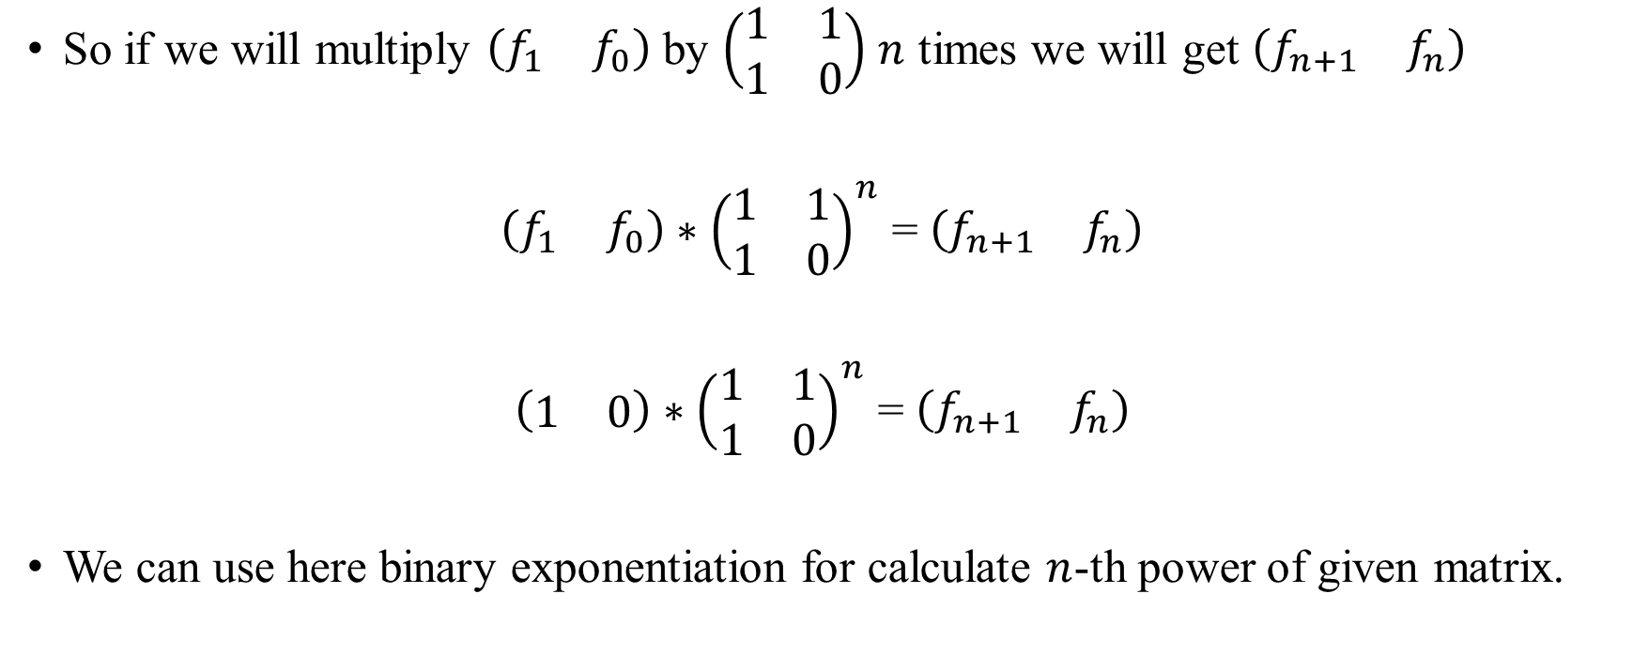
Recurrence relations Matrix calculation. Fibonacci example.
So if we will multiply $\left(\begin{matrix}f_{1} & f_{0}\end{matrix}\right)$ by $\left(\begin{matrix}1 & 1 \\ 1 & 0\end{matrix}\right)$ $n$ times we will get $\left(\begin{matrix}f_{n+1} & f_{n}\end{matrix}\right)$
$\left(\begin{matrix}f_{1} & f_{0}\end{matrix}\right)∗$ ${\left(\begin{matrix}1 & 1 \\ 1 & 0\end{matrix}\right)}^{n}$ = $\left(\begin{matrix}f_{n+1} & f_{n}\end{matrix}\right)$
$\left(\begin{matrix}1 & 0\end{matrix}\right)∗$ ${\left(\begin{matrix}1 & 1 \\ 1 & 0\end{matrix}\right)}^{n}$ = $\left(\begin{matrix}f_{n+1} & f_{n}\end{matrix}\right)$
We can use here binary exponentiation for calculate $n$-th power of given matrix.

Slide 4

Recurrence relations Matrix calculation. Fibonacci example.
So how we got $\left(\begin{matrix}1 & 1 \\ 1 & 0\end{matrix}\right)$?
Fibonacci numbers formula is $f_{n}=f_{n−1}+f_{n−2}$.
We can reformulate this formula as $f_{n}={α_{1}f}_{n−1}+{α_{2}f}_{n−2}$, where $α_{1}=α_{2}=1$.
Matrix is $\left(\begin{matrix}α_{1} & 1 \\ α_{2} & 0\end{matrix}\right).$

Slide 5

Recurrence relations Matrix calculation
So we can easily calculate various relations:
For example: $a_{n}=2∙a_{n−1}+4 ∙a_{n−2} −5∙a_{n−3}$
Matrix compatible for this relation is $\left(\begin{matrix}\begin{matrix}2 & 1 \\ 4 & 0\end{matrix} & \begin{matrix}0 \\ 1\end{matrix} \\ \begin{matrix}−5 & 0\end{matrix} & 0\end{matrix}\right)$.

Slide 6
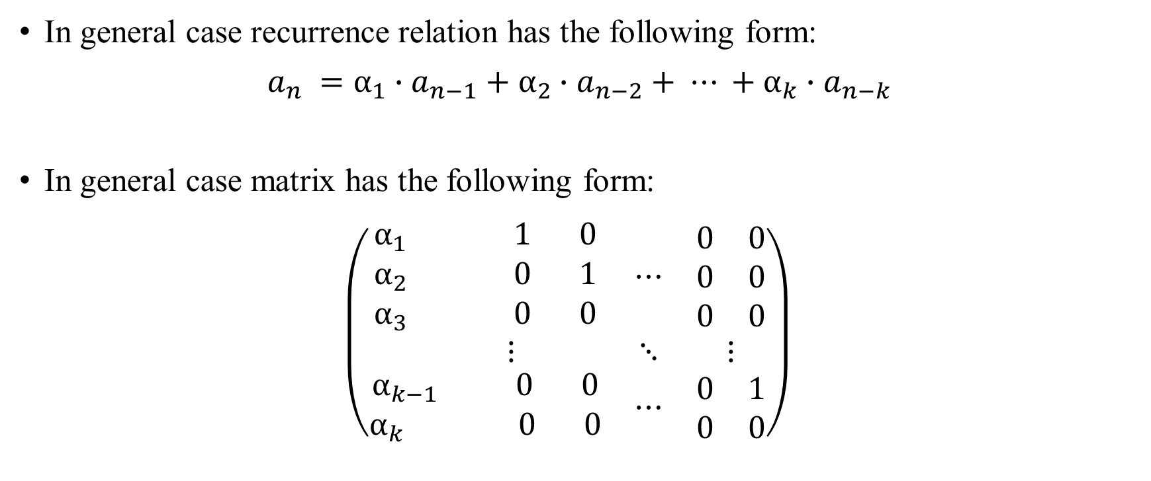
Recurrence relations Matrix calculation
In general case recurrence relation has the following form:
$a_{n} =α_{1}∙a_{n−1}+α_{2}∙a_{n−2}+ ⋯ +α_{k}∙a_{n−k}$
In general case matrix has the following form: $\left(\begin{matrix}\begin{matrix}α_{1} & 1 & 0 \\ α_{2} & 0 & 1 \\ α_{3} & 0 & 0\end{matrix} & ⋯ & \begin{matrix}0 & 0 \\ 0 & 0 \\ 0 & 0\end{matrix} \\ ⋮ & ⋱ & ⋮ \\ \begin{matrix}\begin{matrix}α_{k−1} & 0 & 0\end{matrix} \\ \begin{matrix}α_{k} & 0 & 0\end{matrix}\end{matrix} & ⋯ & \begin{matrix}0 & 1 \\ 0 & 0\end{matrix}\end{matrix}\right)$

